Slide 1
CSE 417T Introduction to Machine Learning
Lecture 23
Instructor: Chien-Ju (CJ) Ho

Slide 2
Logistics
Homework 5 is due Apr 19 (Tuesday)
Exam 2 will be on April 28 (Thursday)
Will focus on the topics in the second half of the semester
Format / logistics will be similar with what we have in Exam 1
Timed exam (75 min) during lecture time in the classroom
Closed-book exam with 2 letter-size cheat sheets allowed (4 pages in total)
No format limitations (it can be typed, written, or a combination)
April 26 (Tuesday) will be a review lecture

Slide 3
Recap

Slide 4
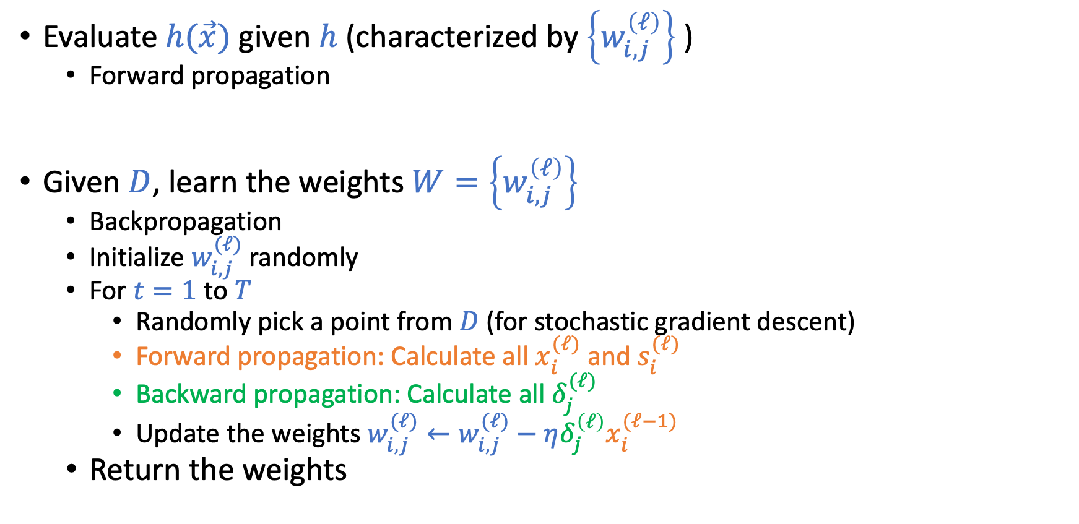
Neural Network
Evaluate $h(\vec{x})$ given $h$ (characterized by $\left\{w_{i,j}^{\left(ℓ\right)}\right\}$ )
Forward propagation
Given $D$, learn the weights $W=\left\{w_{i,j}^{\left(ℓ\right)}\right\}$
Backpropagation
Initialize $w_{i,j}^{(ℓ)}$randomly
For $t=1$ to $T$
Randomly pick a point from $D$ (for stochastic gradient descent)
Forward propagation: Calculate all $x_{i}^{(ℓ)}$ and $s_{i}^{(ℓ)}$
Backward propagation: Calculate all $δ_{j}^{(ℓ)}$
Update the weights $w_{i,j}^{(ℓ)}←w_{i,j}^{(ℓ)}−η{δ_{j}^{\left(ℓ\right)}x}_{i}^{(ℓ−1)}$
Return the weights

Slide 5
Deep Neural Network
“Shallow” neural network is powerful (universal approximation theorem holds with a single hidden layer). Why “deep” neural networks?
Each layer captures features
of the previous layers.
We can use “raw data” (e.g., pixels of an image) as input. The hidden layer are extracting the features.
Design different network architectures to incorporate domain knowledge.

Slide 6
Some Techniques in Improving Deep Learning
Regularization to mitigate overfitting
Weight-based, early stopping, dropout, etc
Incorporating domain knowledges
Network architectures (e.g., Convolutional Neural Nets)
Improving computation with huge amount of data
Hardware architecture to improve parallel computation
Improving gradient-based optimization
Choosing better initialization points

Slide 7
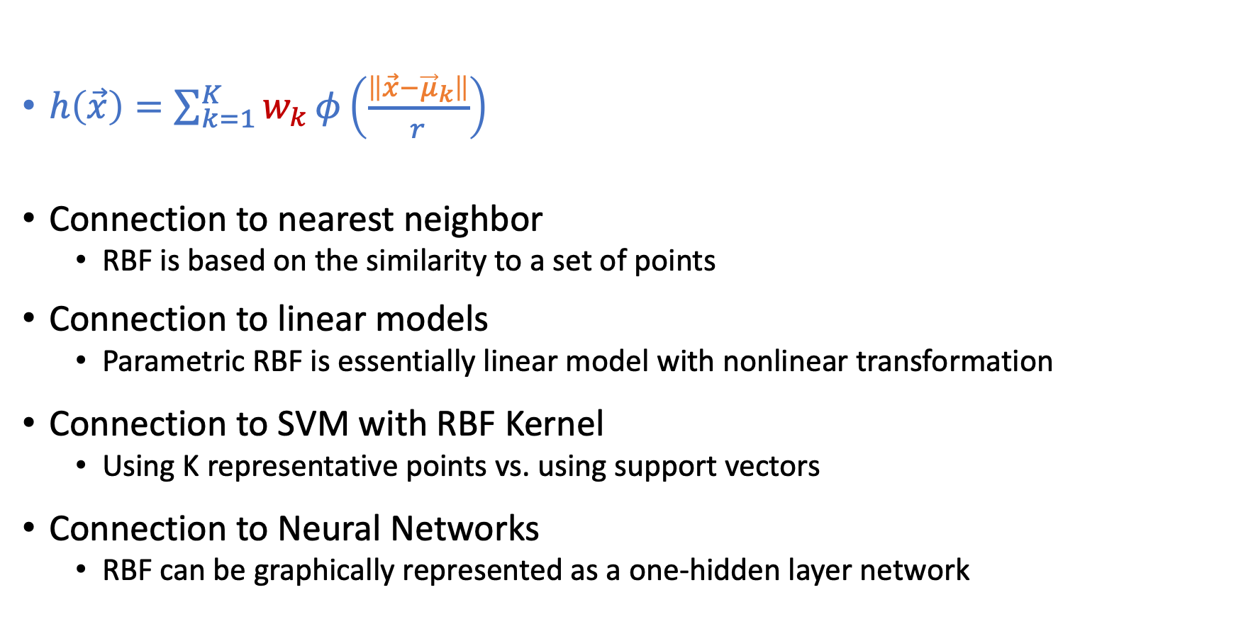
Radial Basis Functions (RBF)
$h\left(\vec{x}\right)=\sum_{k=1}^{K}{w_{k}}φ\left(\frac{\left\|\vec{x}−{\vec{μ}}_{k}\right\|}{r}\right)$
Connection to nearest neighbor
RBF is based on the similarity to a set of points
Connection to linear models
Parametric RBF is essentially linear model with nonlinear transformation
Connection to SVM with RBF Kernel
Using K representative points vs. using support vectors
Connection to Neural Networks
RBF can be graphically represented as a one-hidden layer network

Slide 8
Machine Learning Lifecycle
For ML to have “positive” impacts, we need to be careful in every stage
Feedback
Task Definition
Deployment
Dataset Construction
What we covered
(and majority of ML research)
Testing
Model Definition
Training

Slide 9
Today’s Lecture

Slide 10
Types of Learning
Supervised learning (the focus of this course)
Given training data (input, correct output)
Try to predict the output for data not seen before
Unsupervised learning
Given data in the form of (input)
Find patterns in data
Reinforcement learning
Learn how to act, based on rewards for actions

Slide 11
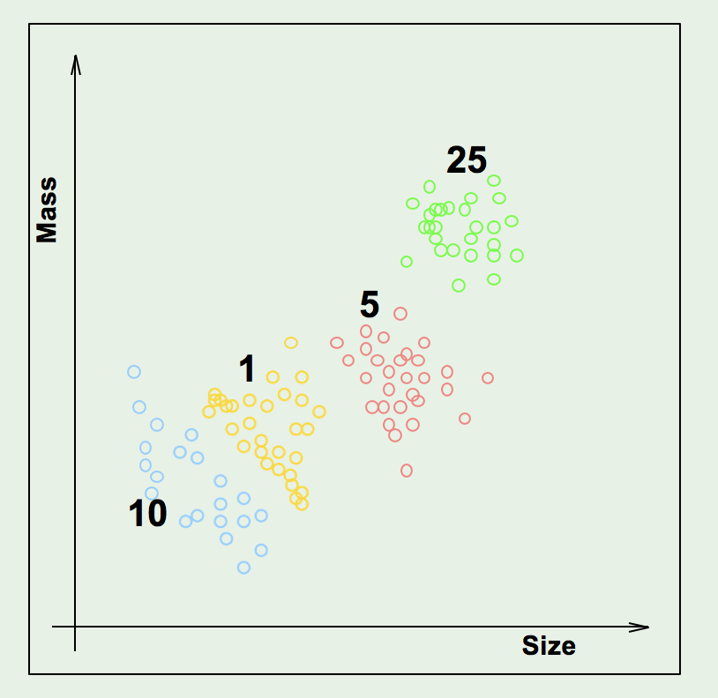
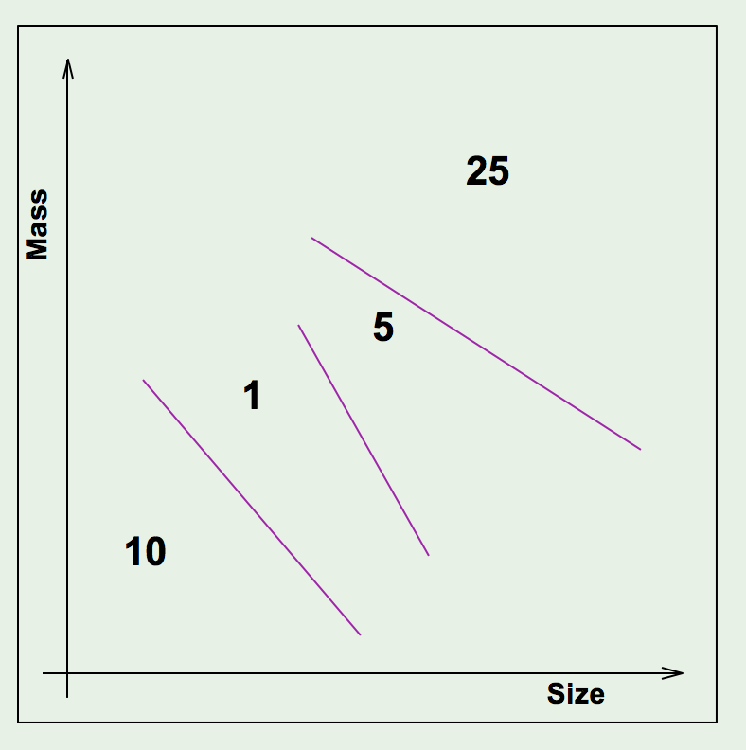
Supervised Learning
Given data with (input, correct output), learn a pattern that can predict previously unseen data

Slide 12
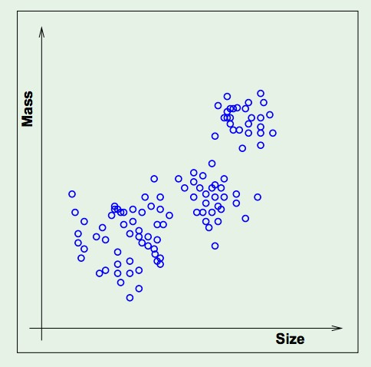
Unsupervised Learning
Suppose you only have the feature vectors but no labels. Still want to describe the data in some useful way.

Slide 13
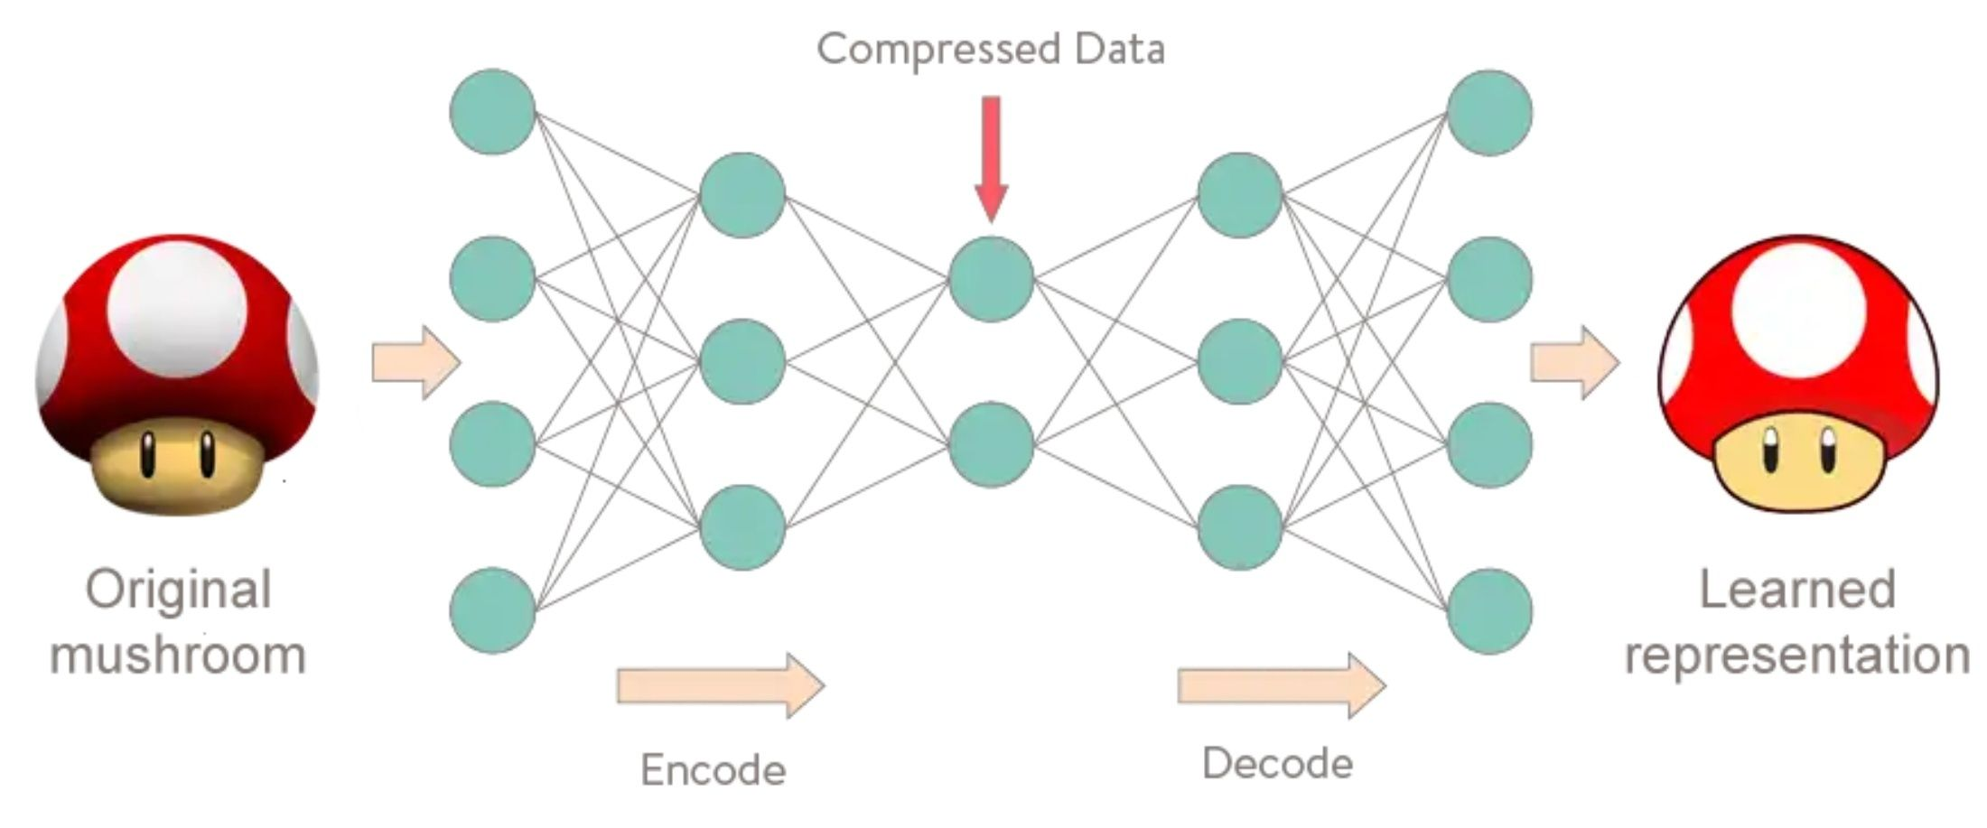
Unsupervised Learning
Suppose you only have the feature vectors but no labels. Still want to describe the data in some useful way.

Slide 14
A Short Introduction of Reinforcement Learning
[The entire section of reinforcement learning is safe to skip for the exam]

Slide 15
Illustrating Applications
Consider the following tasks
News site: picks a news header to show to each user; don’t know user preferences a priori Goal: maximize #clicks.
Dynamic pricing: Pick a price for your product; don’t know customer information a prori Goal: maximize total profit.
Personalized health advice: Pick a recommendation of activity; don’t know user adoption chance a priori Goal: maximize #adopted recommendations
…
Overall goal:
Maximizing total rewards from actions without knowing the rewards in advance
Learning by doing
[Safe to Skip for the Exam]

Slide 16
Multi-Armed Bandit
One classical formulation for reinforcement learning

Slide 17

One-Armed Bandit
= Slot Machine

Slide 18
Multi-Armed Bandit
Choose a slot machine to pull at each time
IID Rewards: each arm reward is iid drawn from unknown distribution
Bandit feedback: Observe only the reward of your choice
Goal:
Maximize the total rewards you obtain
Equivalently, minimize regret
Regret:
Utility(OPT) - Utility(ALG)
A classical framework for studying exploration-exploitation tradeoff
[Safe to Skip for the Exam]

Slide 19
Example
Which interface design should I use for my website?
Epsilon first
Exploration: For an initial epsilon population, randomly split them into seeing A or B
Exploitation: Choose the one with better empirical “performance” afterwards
How much should we explore? Can we adaptively explore?
[Safe to Skip for the Exam]

Slide 20
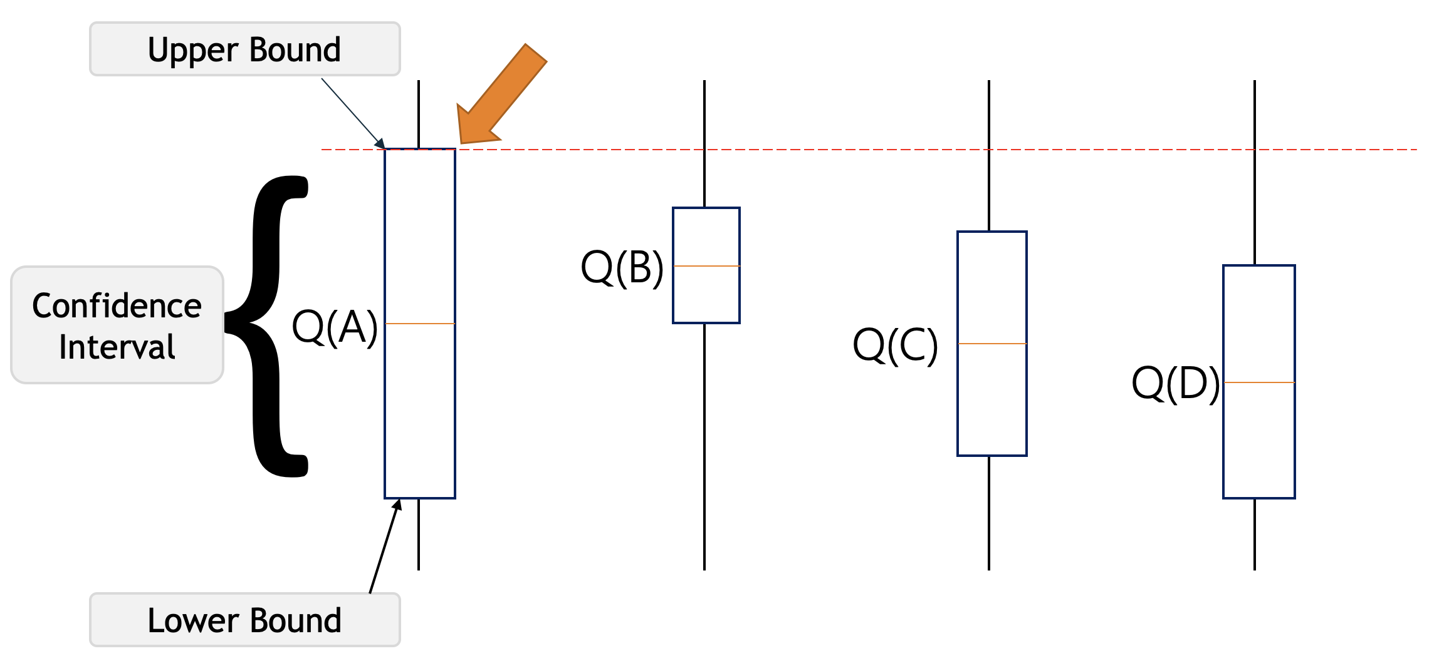
Adaptive Algorithm: Upper Confidence Bound (UCB)
An index-based method for stochastic bandits
Maintain an index for each arm k at every time t
Select the arm with the largest index
UCB achieves regret bound O(log T) in stochastic settings
Empirical mean:
exploitation
Confidence interval:
exploration
Common goal: Sublinear regret / no-regret:
Regret / T -> 0; converges to optimal action
[Safe to Skip for the Exam]

Slide 21
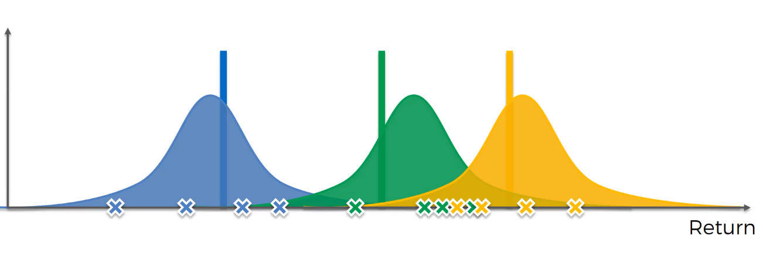
Adaptive Algorithm: Thompson Sampling
Thompson Sampling Algorithm
Maintain reward distributions of arms
Sample an “index” for each arm based on the distribution
Update the distribution based on observations
Properties:
Theoretically, it also achieves no regrets
Empirically, it usually has superior performance
[Safe to Skip for the Exam]

Slide 22
Many Variations of Multi-Armed Bandits
We might be able to observe rewards for the actions we didn’t take
Full-information feedback vs bandit feedback
What if rewards are not generated stochastically
Adversarial bandits, nonstationary bandits
We might have additional contextual information about the rewards
Contextual bandits
The rewards might depend on the “state” of the environment
Using Markov decision process (MDP) formulation
The “reinforcement learning” problem people usually refer to
Will talk about this next
And more…
[Safe to Skip for the Exam]

Slide 23

[Safe to Skip for the Exam]

Slide 24


In some ways, this actually happens everyday. Consider the slot machine as the algorithm
Human-generated data powers the algorithm
The algorithm influences human welfare
[Safe to Skip for the Exam]

Slide 25
My Own Research: Human-in-the-Loop Bandit Learning
Biased human feedback
The feedback received for selecting an arm might be biased by humans
Learning as incentives
The number of possible actions could increase when humans are involved
Ethical implications
Long-term impacts of actions in bandits
Privacy-preserving online learning
Secure sequential learning
[Safe to Skip for the Exam]

Slide 26
Bandit Learning with Biased Feedback
joint work with Wei Tang
[Safe to Skip for the Exam]

Slide 27
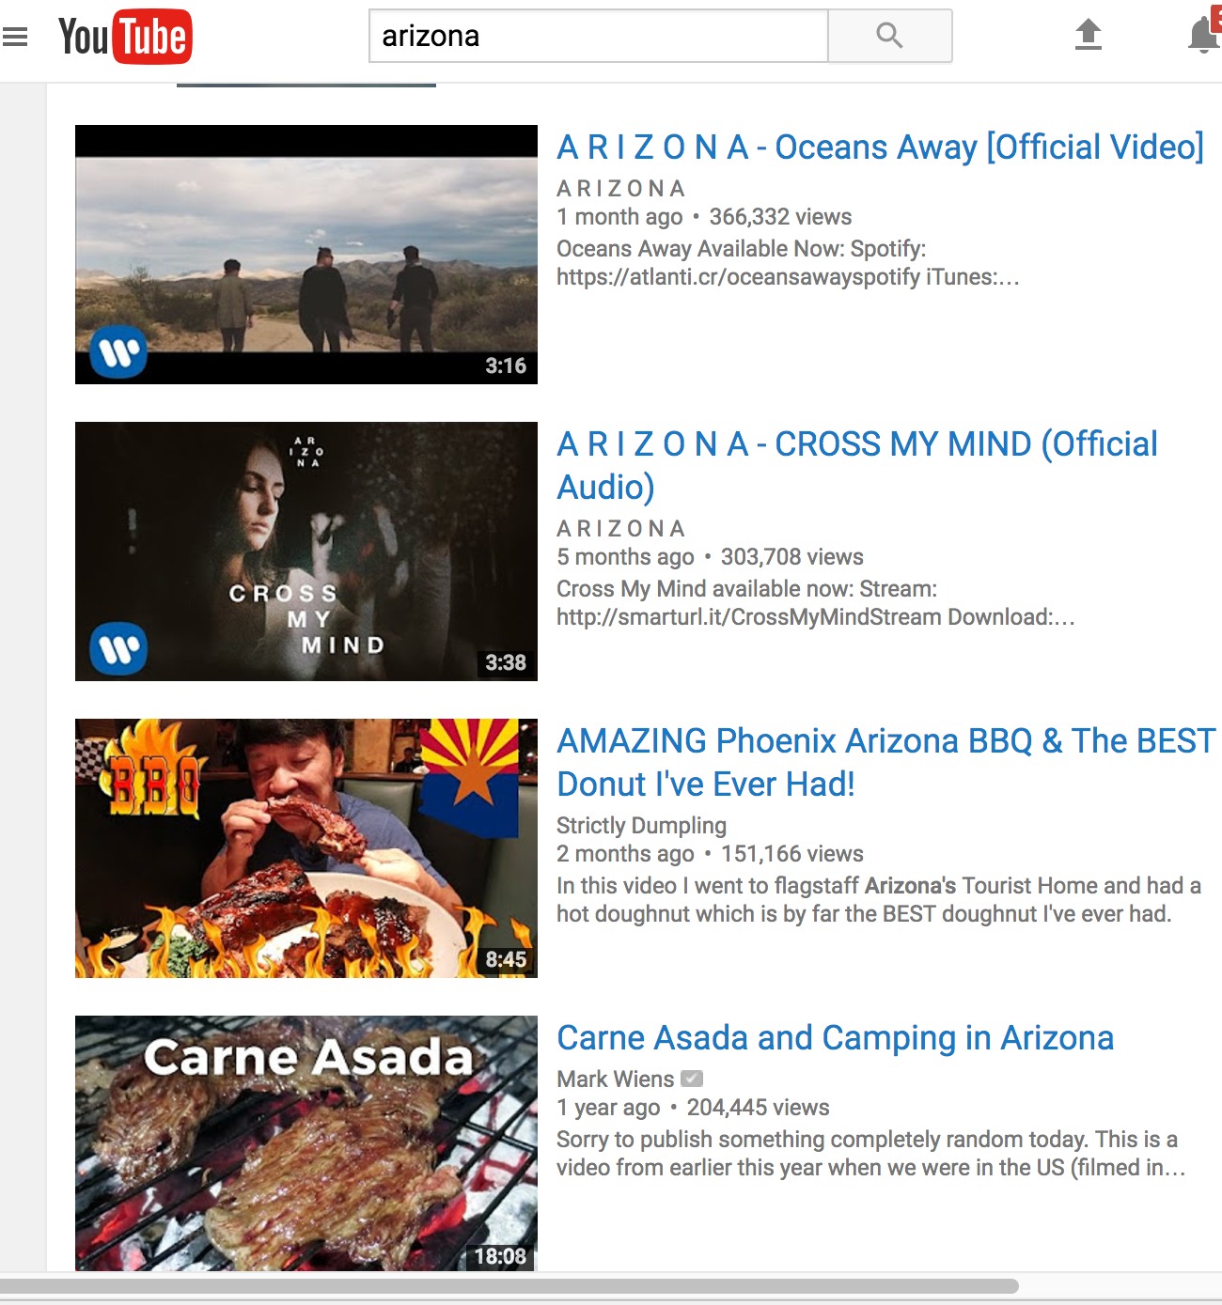
User Generated Content Platforms

Slide 28
A Bandit Formulation
When each new user arrives
Exploration: Show the user some (set of) content to obtain feedback (upvotes, likes, shares, etc)
Exploitation: Show the user the content he/she would enjoy
Goal:
maximize total user happiness
Which may NOT be the same as the total number of positive feedback
Mapping to the bandit formulation
Arm: the content chosen to show to users
[Safe to Skip for the Exam]

Slide 29
Users’ feedback might be biased
In a Reddit-like platform, randomly insert an upvote/downvote to some posts right after they are posted.
Social Influence Bias: A Randomized Experiment. Muchnik et al. Science 2013.
[Safe to Skip for the Exam]

Slide 30

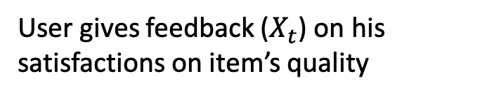
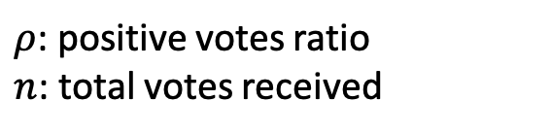

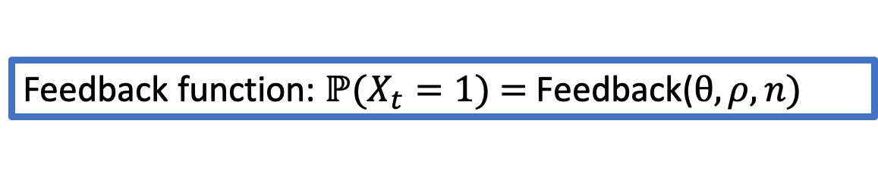
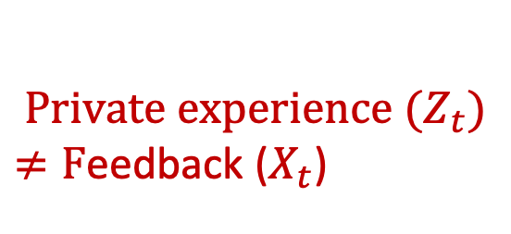
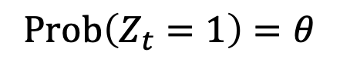
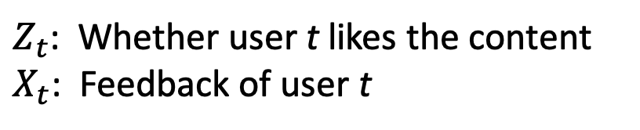
Feedback formulation
$Z_{t}$: Whether user t likes the content
$X_{t}$: Feedback of user t
Recommend item/arm (quality: $θ$)
Algorithm
$${Private experience (Z}_{t})$$
$≠F$eedback ($X_{t}$)
$$Prob\left(Z_{t}=1\right)=θ$$
User gives feedback ($X_{t}$) on his satisfactions on item’s quality
Feedback function: $ℙ(X_{t}=1)\text{ = }\text{Feedback}\text{(}θ, ρ, n)$
$ρ$: positive votes ratio
$n$: total votes received
[Safe to Skip for the Exam]

Slide 31
Can we just recover the true latent quality from (biased) feedback?

Slide 32
Main Results
Explore two general set of bias models
Model 1: feedback is biased by empirical average
Designing no-regret bandit learning (i.e., near-optimal learning) is possible
Model 2: feedback is biased by the whole history
Can’t infer the latent variables
Impossible to achieve no-regret learning
[Safe to Skip for the Exam]

Slide 33
Summary
The models are very stylized, but we show that a small deviation of human behavior could lead to very different outcomes for machine learning.
Implications: with human biases in data generation, sometimes even with infinitely amount of data, we won’t be able to learn.
[Safe to Skip for the Exam]

Slide 34
New Arm Generation in Bandit Learning: An application to User Generated Content Platforms
Joint work with Yang Liu
[Safe to Skip for the Exam]

Slide 35
User-Generated Content: A Bandit Formulation
When each new user arrives
Exploration: Show the user some (set of) content to obtain feedback (upvotes, likes, shares, etc)
Exploitation: Show the user the content he/she would enjoy
The user decides whether to contribute new content
Goal:
maximize total user happiness
Mapping to the bandit formulation
Arm: the content chosen to show to users
Assume user feedback is “unbiased”.
[Safe to Skip for the Exam]

Slide 36
Users are Both Raters and Contributors
When each new user arrives
Exploration: Show the user some (set of) content to obtain feedback (upvotes, likes, shares, etc)
Exploitation: Show the user the content he/she would enjoy
The user decides whether to contribute new content
Goal:
maximize total user happiness
Mapping to the bandit formulation
Arm: the content chosen to show to users
Assume user feedback is “unbiased”.
[Safe to Skip for the Exam]

Slide 37
Why Users Contribute?
Model:
Users likes attention (e.g., attention => money)
Users aim to maximize (Total # views of their content) – (Cost for contributing)
Need to consider learning and incentives simultaneously when designing bandit algorithms.

Slide 38
A Broader Research Agenda: Strategic ML
Goodhart’s law:
“If a measure becomes the public’s goal, it is no longer a good measure.”
[Safe to Skip for the Exam]

Slide 39
History-Dependent Bandits and The Fairness Implications
Joint work with Wei Tang and Yang Liu
[Safe to Skip for the Exam]

Slide 40
Search for “CEO” on search engines
[Safe to Skip for the Exam]

Slide 41
Stereotype Mirroring and Exaggeration
Is this result mirroring the real statistics or an exaggeration?
Assume this is mirroring of the real statistics, are there other concerns?
Are we reinforcing the stereotypes?
Are we being “unfair” to disadvantage groups that are mistreated in the past?
Unequal Representation and Gender Stereotypes in Image Search Results for Occupations. Kay et al. CHI 2015.

Slide 42
In the context of bandit learning
For every action we take, we need to consider its long term impacts.
Examples
Loan applications: Give loans to disadvantage groups could improve their social status in the future.
College admission: The long debate about affirmative action.
Labor markets: Workers might get bored if kept assigned the same type of tasks.
Online advertisements: An advertisement might be less effective if displayed too frequently (over-exposure).
[Safe to Skip for the Exam]

Slide 43
Negative results
Deploying standard bandit algorithms leads to linear regrets.
Simply applying standard algorithms won’t work
Even without considering fairness issues, reinforcing stereotypes is bad for the society from the utility perspective.
[Safe to Skip for the Exam]

Slide 44
What Can We Do?
Rooney rule:
NFL policy - when interviewing head coaches, it is required to include ethnic-minority candidates.
We need to give each “arm” a chance since they might be mis-treated in the past
A special case of affirmative action
There exists setting that applying Rooney rule achieves better overall utility even when each individual decision is sub-optimal.
Main results: Designed order-optimal algorithms
[Safe to Skip for the Exam]

Slide 45
Additional Notes: Achieving Fairness is Hard
There are many possible/reasonable fairness definitions, and they are often not compatible!
FAT*18 Tutorial: 21 Definitions of Fairness and Their Politics. Arvind Narayanan.
Require conversations from people across different disciplines
[Safe to Skip for the Exam]

Slide 46
Markov Decision Process (MDP)
The common formulation for reinforcement learning
[Safe to Skip for the Exam]

Slide 47
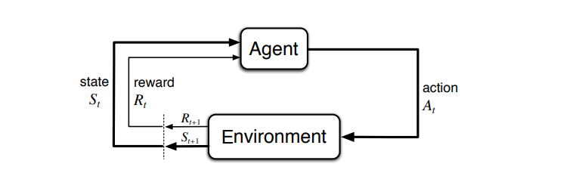
Markov Decision Process
In multi-armed bandits, the rewards depends on actions only (there are some variations to extend this idea)
In many practical applications, the rewards depend on both the actions and the state of the environment.
[Safe to Skip for the Exam]

Slide 48
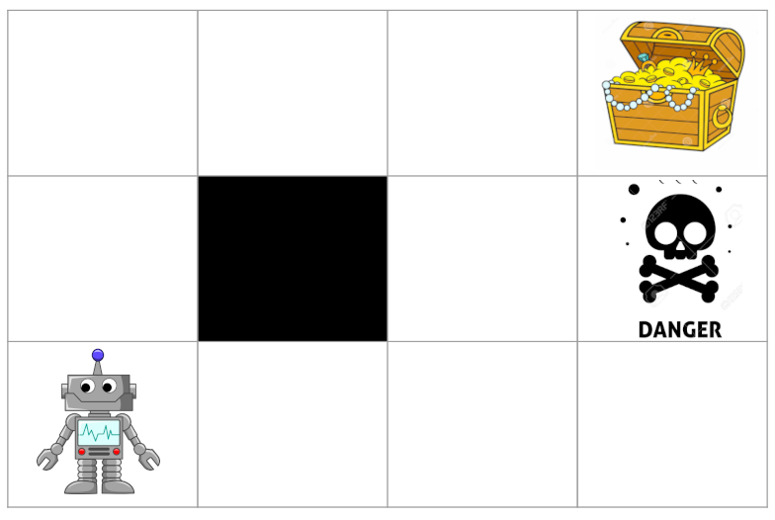
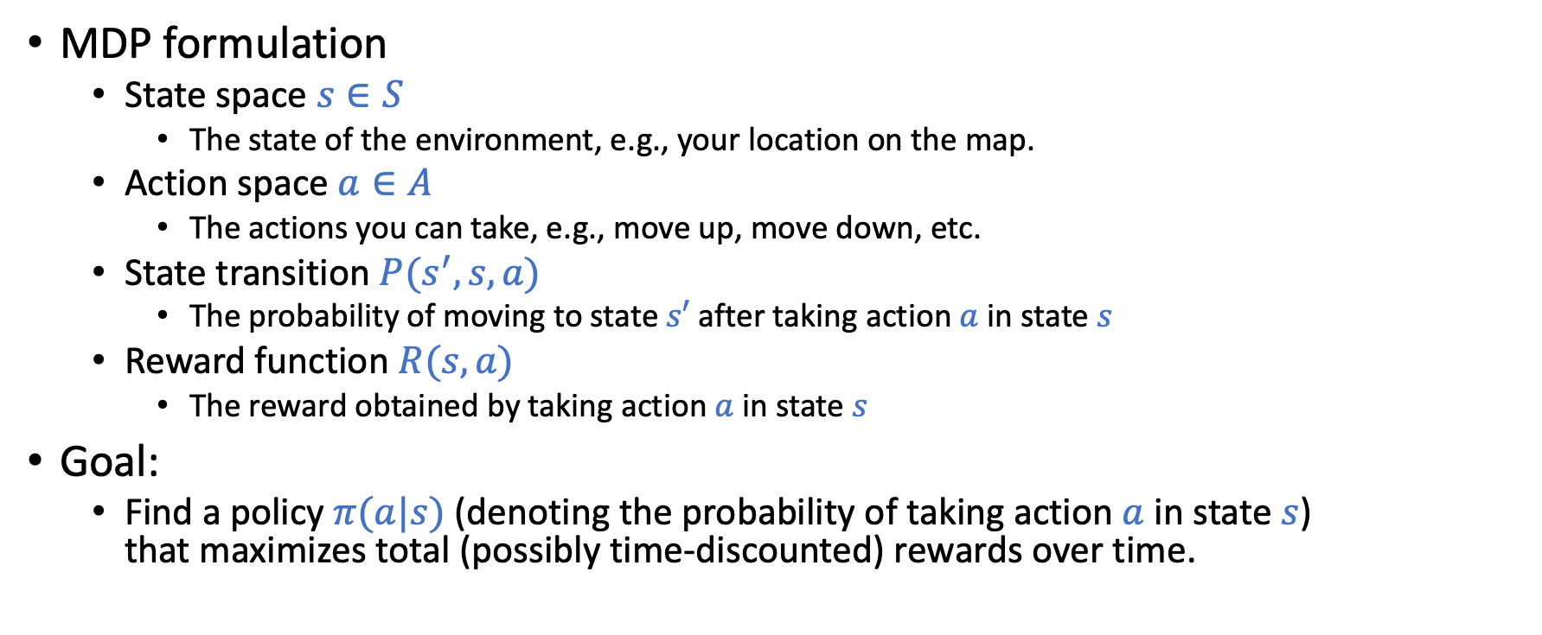
Markov Decision Process
MDP formulation
State space $s∈S$
The state of the environment, e.g., your location on the map.
Action space $a∈A$
The actions you can take, e.g., move up, move down, etc.
State transition $P(s^{′},s,a)$
The probability of moving to state $s′$ after taking action $a$ in state $s$
Reward function $R(s,a)$
The reward obtained by taking action $a$ in state $s$
Goal:
Find a policy $π(a|s)$ (denoting the probability of taking action $a$in state $s$) that maximizes total (possibly time-discounted) rewards over time.
[Safe to Skip for the Exam]

Slide 49
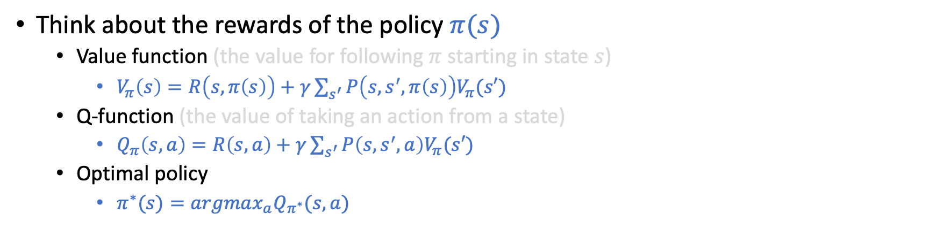
Solving MDP
Think about the rewards of the policy $π(s)$
Value function (the value for following $π$ starting in state $s$)
$V_{π}\left(s\right)=R\left(s,π\left(s\right)\right)+γ\sum_{s^{′}}{P\left(s,s^{′},π\left(s\right)\right)V_{π}(s′)}$
Q-function (the value of taking an action from a state)
$Q_{π}\left(s,a\right)=R\left(s,a\right)+$ $γ\sum_{s^{′}}{P\left(s,s^{′},a\right)V_{π}(s′)}$
Optimal policy
$π^{∗}(s)=argmax_{a}Q_{π^{∗}}(s,a)$
Classical methods
Dynamic programming
Q learning
Value iteration
…
Deep reinforcement learning
Use neural networks to approximate important functions; training through sampling data
Deep Q-learning
Policy Gradient
…
[Safe to Skip for the Exam]

Slide 50
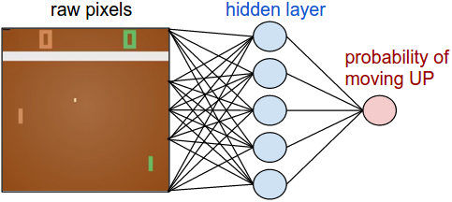
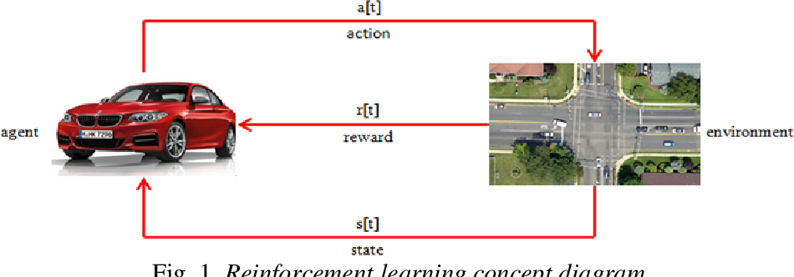
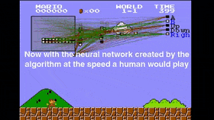
Rich Space of Studies
[Safe to Skip for the Exam]

Slide 51
Next Lecture
Feedback
Task Definition
Where is the data from?
The impact of deployment.
Deployment
Dataset Construction
Testing
Model Definition
Training

